Slide 1
Overview
Context
Uncover the factors that lead to employee attrition and explore important questions relating to attrition rate such as “show me a breakdown of distance from home by job role and attrition”. This is a fictional data set created by IBM data scientists (published on Kaggle.com).

Slide 2
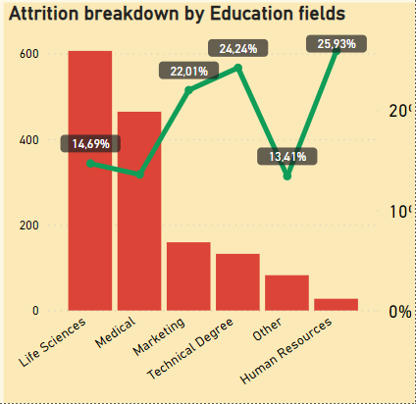
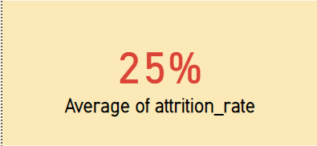
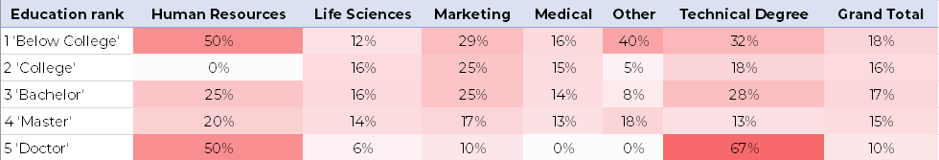
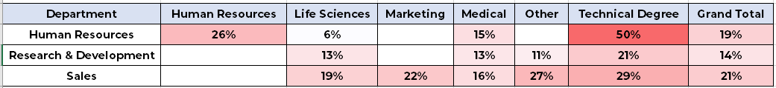
Attrition Rate | Education Status
Attritions rate of employees having majors are Human Resources, Technical Degree and Marketing is significantly higher (over 20%) than the remaining.
Specially, Attrition rate of employees whose majors are HR was 25.93% (higher than average attrition rate (“AAR”) of whole dataset).
Attrition rates of employees whose majors are HR were abnormally high (20-50%) and always in top 2 with every education rank.
Attrition rates of employees whose majors are Technical Degree and worked in non-related department were abnormally high (over AAR).

Slide 3
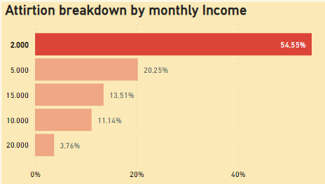
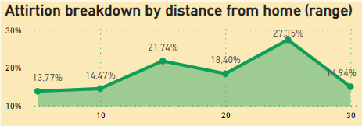
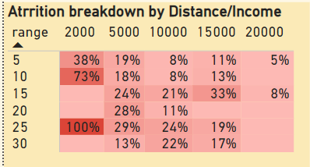
Attrition Rate | Income/Distance
Employees with income up to $2000 have extremely highest attrition rate (54.55%)
Attrition rates tends to increase with distance from home. However, employees whose distances were over 25 km have significantly low attrition rates (14.94%)
Employees with income over $2000, The highest distribution of attrition were employees who live far from offices 15 – 25 km and earn $5000 – $15000 per month.

Slide 4
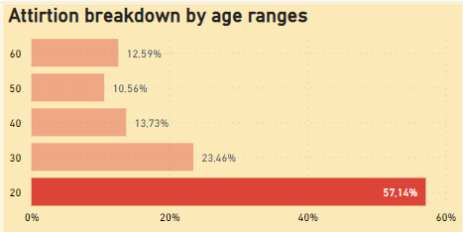
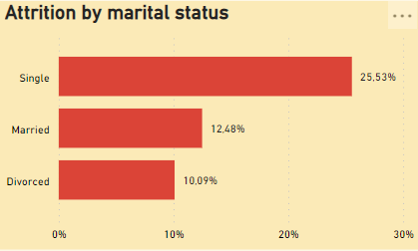
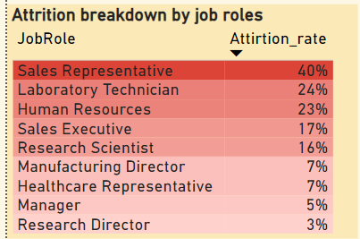
Attrition Rate | Ages/Marital Status/Roles
Employees who were under 20 years old have by far the highest attrition rate (57.14%)
With employees were over 20, The one who was in 21 -30 years old had attrition rate as double as the remaining.
Employees as Sales Representative (Lowest level In Sales) have by far the highest attrition rate (40%). Attrition rates tends to increase with tittle.
The single employees have significantly high attrition rate (25.53%) which was over AAR and as double as the remaining.

